Slide 1

Bird Strike On Aircrafts
PHY1901
19BCE0829 Kandra Ksheeraj

Slide 2

What is the problem?
Bird strikes are a common problem in the aviation industry causing potential damage to the aircraft or its engines.
Bird strikes on aircraft are estimated to cause around 1.6 billion dollars worth of damage each year.
It not only results in significant costs, but can also lead to a plane crash and injury to persons.

Slide 3
What is the problem?
Although the crashes involve a myriad of wildlife, the majority of the crashes involve birds.
Every time a bird collides with an aircraft, a bird strike inspection must be performed to evaluate the hazard.
Bird strikes can have significant economic and occasional safety consequences for flight operations.

Slide 4
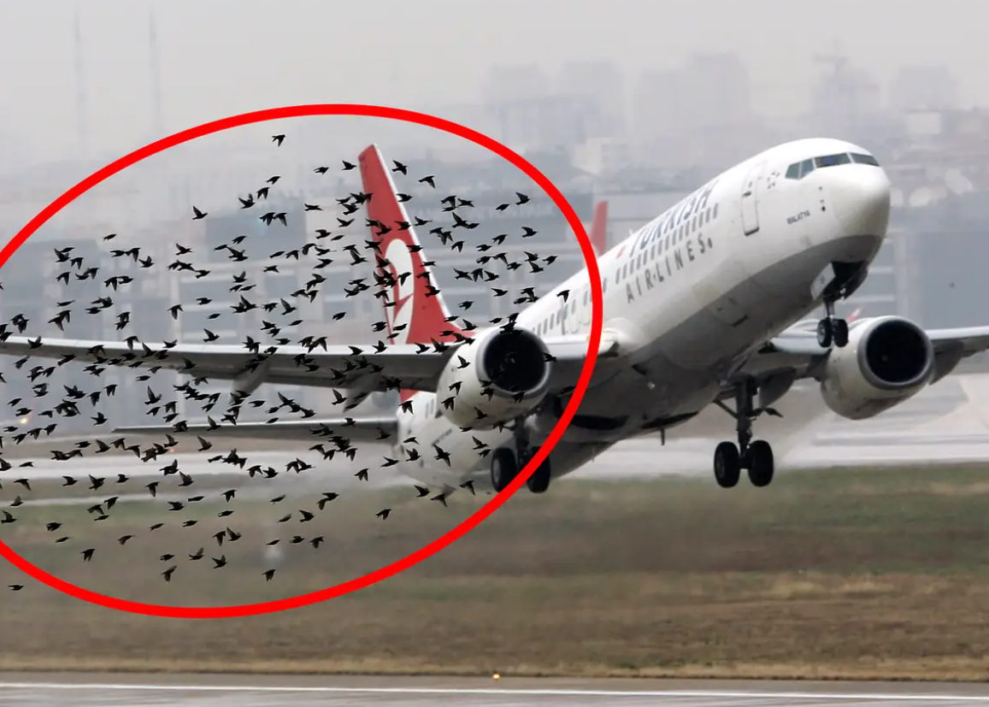
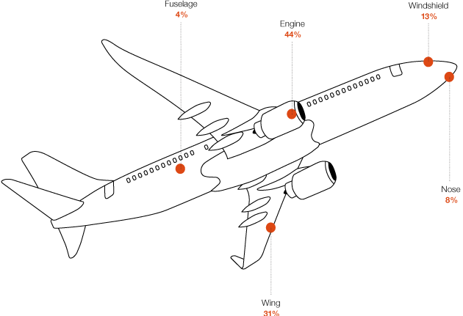
% of Body damage
Example of a bird strike

Slide 5
Existing solutions
In other countries
provide adequate wildlife control measures both natural and artificial
Mesh or grill in front of the engine
Radar systems

Slide 6
Natural wildlife control measures
Shorter vegetation, the netting of water reservoirs, passive bird control measures on buildings and falconry.
The use of saker, peregrine and other falcons with various teams distributed over the day can create hostilities in the affected territory.
Flying models in the form of predators are used. These are controlled by experienced pilots. The models are capable on long ranges and flying high.
Install bird control measures in airport buildings. We provide a number of extremely effective systems e.g. electrical systems, spikes, wire systems etc.

Slide 7
Artificial wildlife control measures
Predator Cry Systems
Birds react to acoustic stimuli. These imitate predator and the warning cries of the birds to be controlled. The habituation effect is reduced by modulating the cries, changing frequencies and intensity.
Visual Methods
Birds perceive light at 532nm wavelength particularly well. The TOM500 laser system is with its green light very effective. The laser is only directed downwards so that it is completely safe.

Slide 8
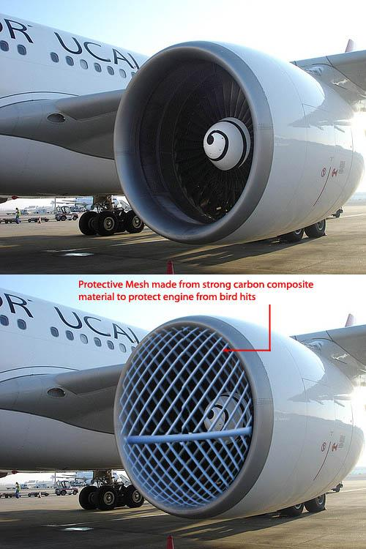
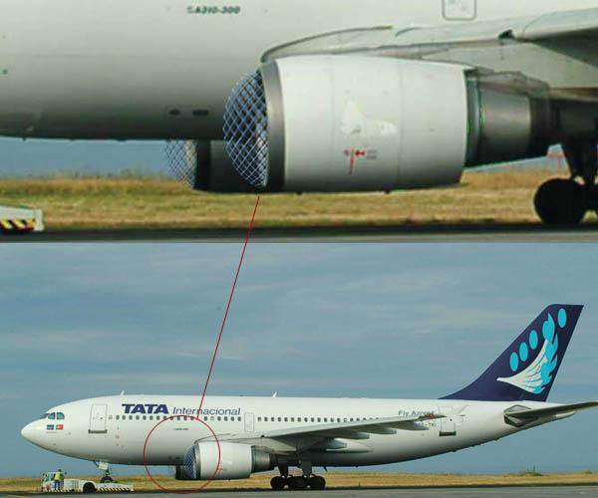
Preventing physically
Mesh in front of engine

Slide 9
Problem
Screen or grate in front of the engine would produce turbulence in the air behind it, and what the engine needs is a smooth flow of air. If the flow is disrupted, the compressor at the front of the engine may stall, causing the engine to lose lift.

Slide 10
TONI Bird Control Systems
The latest radar technology allows the exact localisation of birds and to monitor their behaviour which allows air traffic to be controlled or bird control measures to be initiated.
TONI Bird Control Systems – a team of bird control specialists, ornithologists and radar technicians will provide you with comprehensive and integrated bird strike solutions.
S-band (100mm) radars with a range of 6-8 nm are used with which even the smallest flying object of ca. 2 mm can be plotted.
The latest software analyses the data of all flying objects and classifies them on the basis of their typical flight behaviour.

Slide 11
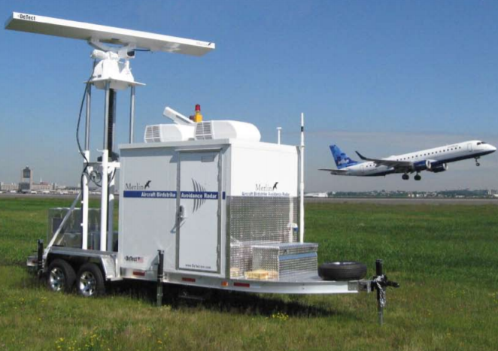
MERLIN Radar
The First Fully Automatic Radar Solution
It analyses the radar raw data using typical flight patterns and automatically classifies the risk to runways.
Fully automatic feedback via monitors to the
airport tower and bird control personnel is
possible also automatic identification and
classification

Slide 12
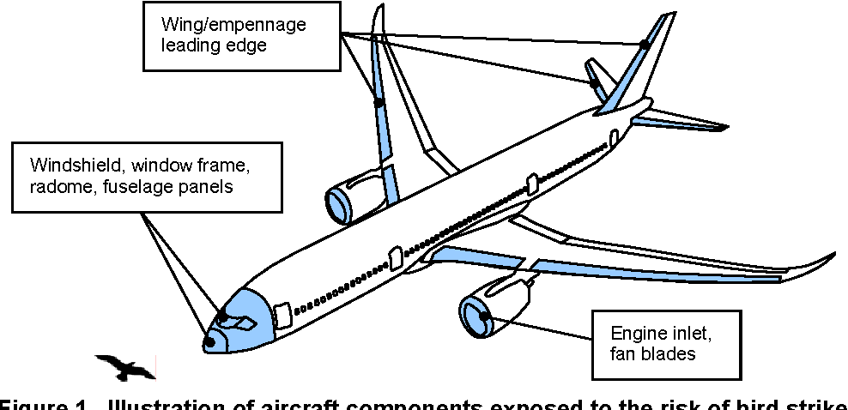
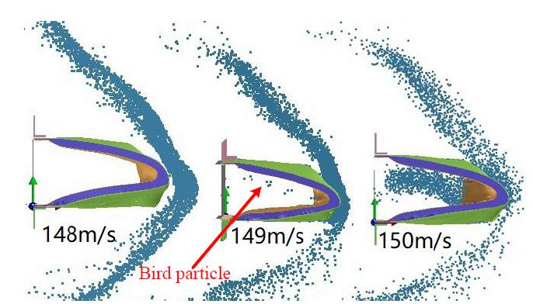
Other methods implementable in India
The German Air Force (Luftwaffe) Method
Basic ecological bird-strike prevention measures include (Wilhem Rulhe, 2008):
Pyrotechnics

Slide 13

Proposed solution
Using Google Cloud Vision
Object Detection:
Object detection systems can be used
to mitigate bird strikes by evaluating
risk before takeoff.
Using Google Cloud’s API Live Object Detection and Tracking to detect objects in live streams, which would be ideal for pilots who need to scan their line of vision in real-time flight.

Slide 14
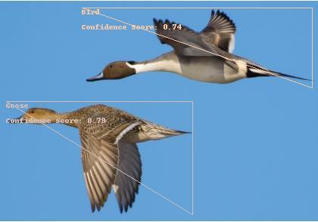
Example of how it works

Slide 15
Proposed Algorithm
The algorithm of the project would involve the use of the Google Application Credentials and Service Key, and having them read and link to the desired JPEG images of the bird wildlife, all saved under the same virtual environment.
Next, the contents of the image would be analyzed and print the number of objects in the image, the classification of the object, and the confidence level.

Slide 16
References
https://www.flightglobal.com/engine-safety-birds-be-gone/98821.article
https://www.boeing.com/commercial/aeromagazine/articles/2011_q3/4/
https://www.researchgate.net/publication/326971379_Case_Study_Aircraft_Accident_and_Bird_Strikes_in_Nepal_Between_1946-2016
https://mainblades.com/bird-strike-inspection/
https://www.sciencedirect.com/science/article/pii/S1000936118301614
http://yedde.blogspot.com/2009/02/aeroplane-bird-hits.html
www.birdstrike.de
https://www.nytimes.com/2009/01/22/nyregion/22engines.html?_r=0

